Slide 1
GRAMMAR AUTO-CORRECTOR by Y Sri Harshitha and K Nireesha

Slide 2
Table of contents
01
Abstract
Introduction
02
Natural Language Processing
03
04
Code

Slide 3
01
Abstract
What is goal of this project?

Slide 4
What is the GOAL?
Main aim is to identify and fix grammatical errors in written text. Grammar auto-corrector leverage natural language processing and machine learning to identify and correct grammatical errors in written text. These powerful tools enhance writing quality and promote clear communication.

Slide 5
02
Introduction
Grammar,NLP

Slide 6
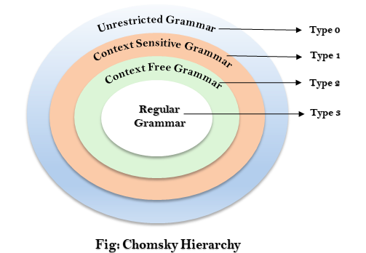
Any Grammar can be represented by 4 tuples--(V,T,P,S)

- Components:
- Non-terminals(V): Symbols used to help define the grammar rules.
-Terminals(T): The actual symbols of the language (e.g., characters or words).
- Production Rules(P): Rules that define how non-terminals can be replaced by terminals or other non-terminals.
- Start Symbol(S): A special non-terminal from which production starts

Slide 7
Real-World Applications:
While the current implementation serves as a proof of concept, real-world applications would require a more robust approach:
•
Academic and Professional Use: In theoretical computer science or related fields, a more sophisticated tool could assist in writing and validating formal notations and proofs.
Educational Tools: Such a system could be integrated into educational tools to help students and researchers learn and apply correct notation.

Slide 8
03
Natural Language Processing

Slide 9
Natural Language Processing (NLP) is a branch of artificial intelligence that focuses on the interaction between computers and human language.
It involves the development of algorithms and models that allow computers to understand, interpret, and generate human language in a way that is both meaningful and useful.

Slide 10
ROLE OF NLP
TOKENIZATION: This is the process of breaking down text into individual words or tokens. For grammar correction, this helps in analyzing each word or token in context.
PARSING: Parsing involves analyzing the syntactic structure of sentences. Grammar autocorrectors use parsing to understand how words are related and to detect errors in sentence structure.
ERROR DETECTION&CORRECTION: NLP models, often powered by machine learning, are trained on large corpora of text to recognize common grammatical errors and suggest corrections. These models learn from examples of correct and incorrect grammar usage.

Slide 11
CODE
import nltk
from nltk import CFG
from nltk.parse import EarleyChartParser # Import the EarleyChartParser class from nltk.parse
# Define a simple CFG for theoretical computer science notation
cfg_grammar = CFG.fromstring("""
S -> NP VP
NP -> DT NN | DT NN PP
PP -> IN NP
DT -> 'a' | 'the'
NN -> 'machine' | 'algorithm' | 'state' | 'system'
IN -> 'in' | 'with'
VP -> V NP | V PP
V -> 'is' | 'uses'
""")
def parse_sentence(sentence, parser):
tokens = word_tokenize(sentence.lower())
try:
parses = list(parser.parse(tokens))
return parses
except ValueError:
return []
def correct_sentence(sentence, parser):
parses = parse_sentence(sentence, parser)
if parses:
return sentence # If parsing succeeds, no correction is needed
else:
# Simple correction: return a default message for invalid sentences
return "Syntax error detected. Please check the sentence structure."

Slide 12
def main():
parser = EarleyChartParser(cfg_grammar) # Use EarleyChartParser instead of EarleyParser
# Example usage
input_sentence = "the machine is with algorithm"
corrected_sentence = correct_sentence(input_sentence, parser)
print("Original sentence:", input_sentence)
print("Corrected sentence:", corrected_sentence)
if __name__ == "__main__":
main()

Slide 13

RESULT
Grammar auto-corrector will continue to evolve, leveraging advancements in NLP and Finally ensuring grammar auto-correction can handle diverse and evolving language constructs without significant performance degradation.
Improved Communication:
-Grammar auto-correctors enhance the clarity and professionalism of written communication.
Time-Saving:
-Automated grammar correction saves users time and effort, allowing them to focus on content.
➢

Slide 14
CONCLUSION
The project successfully demonstrated the basic concept of a grammar auto-corrector using CFG and parsing techniques. However, to be fully functional and useful, the system requires enhancements in grammar coverage, error correction capabilities, and user interaction.

Slide 15


